Slide 1


Enhancing cancer patient’s well-being and health status improvement following treatment using AI methods project ONCORELIEF
S. Venios¹, S. Koussouris¹, A. Scherrer², S. Likothanassis^{3,5}, F. Mousa⁴, S. Diamantopoulos⁵, M. Plakia⁵
¹Suite5 Data Intelligence Solutions Limited, Limassol, Cyprus
²Fraunhofer-Institut für Techno- und Wirtschaftsmathematik ITWM, Kaiserslautern, Germany
³University of Patras, Patras and CERTH, Thessaloniki, Greece
⁴MCS Data Labs GmbH, Berlin, Germany
⁵EXUS AI Labs, Athens, Greece
⁵ CERTH-ITI, Greece
This project has received funding from the European Union’s Horizon 2020 Framework Programme for Research and Innovation under grant agreement no 875392.
Copyright © 2020 The ONCORELIEF Consortium

Slide 2
Introduction
ONCORELIEF
improves post-treatment health status, well-being and follow-up care for cancer patients
in order to meet their needs and allow for timely suggestions
before these patients face increased therapeutic side-effects, emotional distress, or biobehavioural factors promoting cancer progression.
Project Objectives
1
2
3
4
5
Analyze clinical settings, treatment parameters and environment dynamics and drive forces of cancer patient wellbeing
Exploit Big Data and AI capabilities for holistic post-treatment insights generation
Develop innovative technological elements for providing personalized wellbeing
Validate in different cancer types and patient-environment settings
Actively engage stakeholders resulting to measurable impacts

Slide 3
Project Overview
Trained AI models are downloaded to personal, portable devices in order to locally analyze individual data and to generate QoL (Quality of Life) indices, recommendations and warnings for the patients using the application
Back-end Data Platform: data which are securely collected from heterogeneous sources, are then anonymised, annotated and stored here
AI Engine: built on top of the back-end platform, harvests and analyses data, extracts patterns, produces meaningful AI models and updates them accordingly, produces correlations
A downloadable application (ONCORELIEF Guardian Angel): available for portable devices, connected to the ONCORELIEF platform and to the patients’ sensing devices. It runs locally and uses models produced by the AI engine to extract insights on the patient life and condition and make suggestions
The GA may optionally send data back to the AI Engine both for research-related reasons (another source of big data) and for computation offloading reasons (mobile AI module not powerful enough)

Slide 4
Data Sources & Data Model
Measurements from wearable sensors
Data from questionnaires answered by the patients
Data from the medical record of the patient
dynamic data (time dependent)
static data (that could be updated when they change)
According to the adopted ONCORELIEF Data Model, the data are transformed to FHIR format and stored to the back-end storage
A number of about 300 different patients, on follow-up from Colorectal Cancer (CRC) and Acute Myeloid Leukaemia (AML) are expected to provide the training data

Slide 5
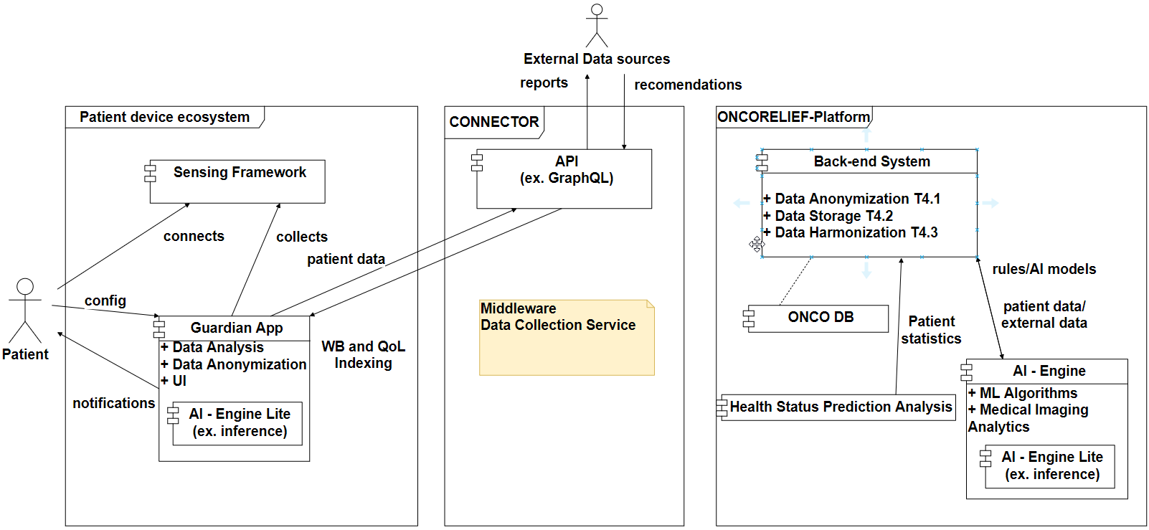
Architecture Overview

Slide 6
Quality of Life (ONCORELIEF index)
Depends on
  Physical aspects
  Psychological aspects
  Social aspects
  Spiritual aspects
Input
Output
  Quality of Life index (0 – 1000)
    901 – 1000: Very Good
    801 – 900: Good
    601 – 800: Faulty
    401 – 600: Poor
    < 400: Very poor
The table presents an initial approach of grouping the different needs into categories. The contribution of each need to each category is not equal and depends on a weight which will be defined during the pilot operation of the project and will be optimised.
AML |  |  | CRC
Category | Included Needs |  | Category | Included Needs
Distress | Depression Anxiety Other needs |  | Distress | Depression Anxiety Other needs
Psycho-physiological | Sleep Fatigue Lack of sexual interest Other needs |  | Psycho-physiological | Fatigue Other needs
Physical symptoms | Sore mouth Hair loss Weight loss Other needs |  | Physical symptoms | Colitis Appetite Loss Peripheral neuropathy Weight Hand-Foot Syndrome Other needs
Wearables | Questionnaires
Heart Rate via PPG | PHQ9 (depression)
Oxygen Saturation (SaO2) via PPG | HADS (anxiety and depression)
Skin Temperature | HFS (hand-foot syndrome)
1-channel-ECG | ISI (sleep quality)
… | …

Slide 7











Quality of Life Calculation
Baseline QoL index
  $Q=w_{n}Q_{n}+w_{an}Q_{an}$, $w_{n}$: initially set to 80%, $w_{an}$: initially set to 20%
    $Q_{n}=\frac{1}{N_{n}}\sum_{i=1}^{N_{n}}{x_{i}}$, $x_{i}$: Needs
    $Q_{an}=\frac{1}{N_{an}}\sum_{i=1}^{N_{an}}{y_{i}}$, $y_{i}$: Additional needs
The baseline QoL has been currently implemented based on questionnaire data
$$x_{1}$$
Needs
$$x_{2}$$
avg
$$w_{n}$$
…
$$x_{N_{n}}$$
$$Σ$$
$$Q$$
$$y_{1}$$
$$y_{2}$$
avg
$$w_{an}$$
Additional needs
…
$$y_{N_{an}}$$

Slide 8
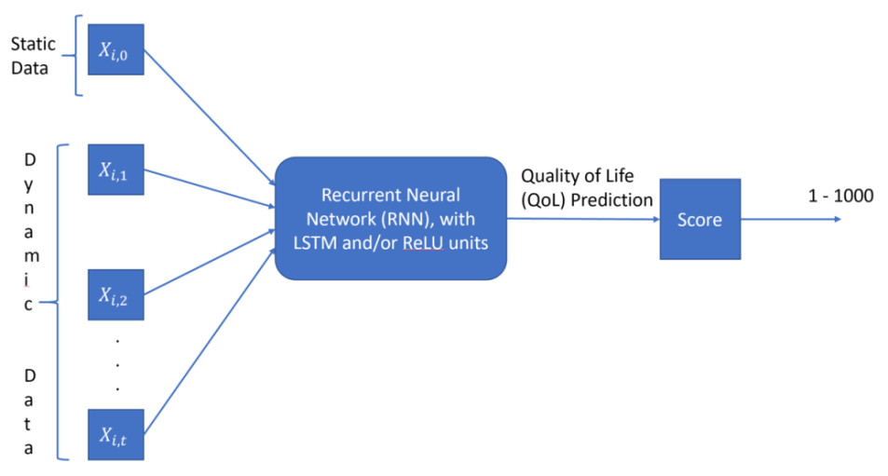
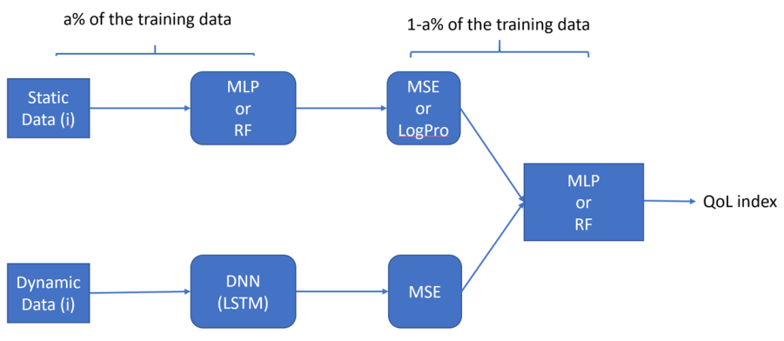
Quality of Life Prediction
Machine Learning-based
  RNN architecture
    Combines static and dynamic data
    Uses recent historical data in a specified time window
  Ensemble learning architecture
    Different models for static and dynamic data
      Static: MLP, RF, etc.
      Dynamic: LSTM
    Combines the outputs of the two models
  Training using baseline QoL as ground truth
  Personalized to each patient

Slide 9
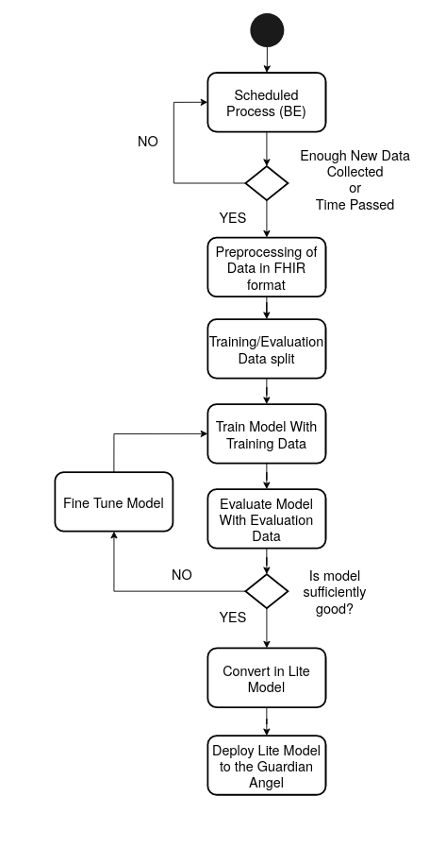
Training Process

Slide 10
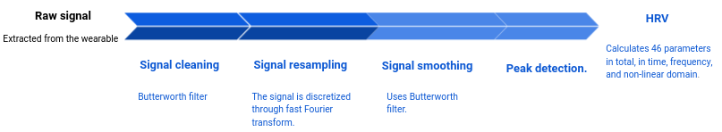
Heart Reate Variability (HRV) Calculation
What it is?
An statistical report of the
behaviour of the heart beats.
How is it calculated?
Raw PPG data is collected employing a wearable device in the wrist to generate a photoplethysmography (PPG) that detects blood volume changes in the microvascular bed of tissue is possible to monitor the cardiac cycle
Data is cleaned with filters and resampled
R to R peaks are detected
Inter Beat Intervals (IBI’s) are calculated based on the R to R peaks
HRV with 46 parameters in total is calculated (this is much more than usually used by doctors)

Slide 11
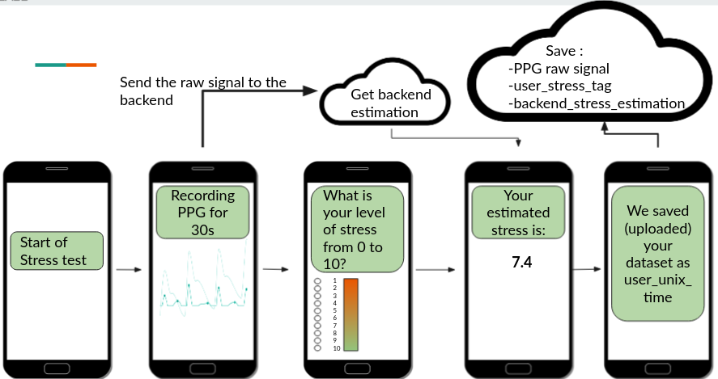
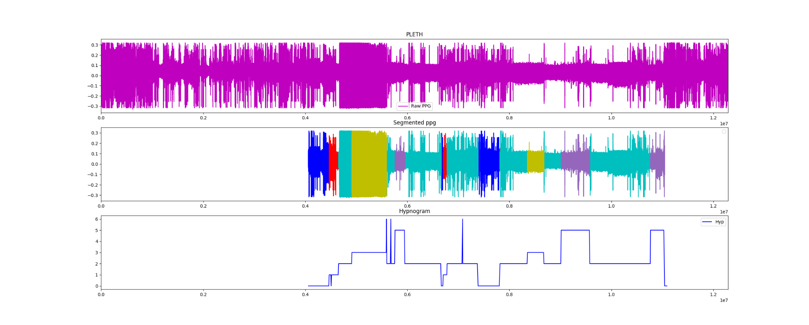
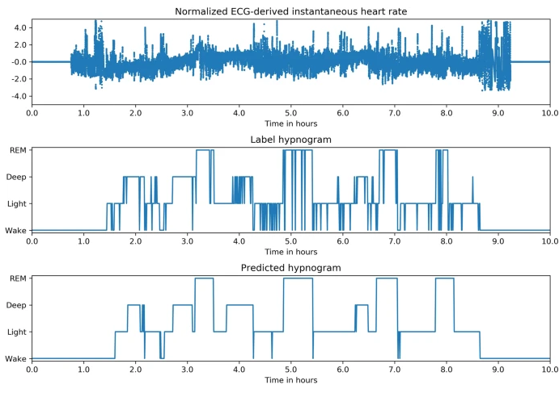
Stress Levels & Sleep Quality Estimation
The normalized HRV is used as input for Convolutional Neural Networks (CNNs) to:
estimate stress levels
to identify features of the photoplethysmogram (PPG) pulse wave which are indicative of mental stress.
assess sleep quality
A full CNN was trained to classify the sleep stages. Two DNN work in the backend: one estimates the four sleep stages and the second estimates whether the person is asleep or not.
Testing app for the stress inference
Resulting hypnogram from the DNN inference, given the Raw PPG signal (top)

Slide 12
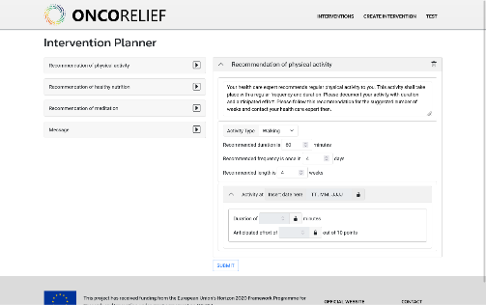



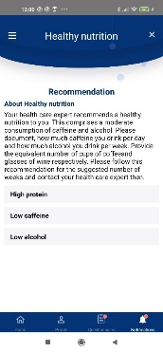
Suggestions planning
Combination of predefined suggestions with analytic results from AI Engine as information input
  Analytic results act as quality indicators to ensure the relevance of individual suggestions for a specific patient case
Selection of suitable suggestions by the Physician (Doctor) with the help of interactive decision support features
Computation of condition logic from suggestions on documented patient data
  Second order predicate logic on crucial case parameters
Transfer of selected suggestions to Guardian Angel app
Display of suggestion messages in Guardian Angel UI
Obtain feedback on suggestions by Guardian Angel user
AI Engine
( ( ANY suggestion_start FULFILLS ( CURRENT_DATE GREATEROREQUAL suggestion _start ) ) AND ( ANY suggestion_end FULFILLS ( CURRENT_DATE SMALLEROREQUAL suggestion_end ) ) AND (suggestion_status EQUAL \"running\" ) )
Suggestion planning
Condition logic
You do your physical activity therapy as scheduled. That’s good, go on with it!
Guardian
Angel app
Feedback messages

Slide 13


ONCORELIEF Pilots
The project's results will be validated in in real world settings in two pilot hospitals, focusing on Colorectal Cancer and Acute Myeloid Leukaemia, respectively. During the pilot execution, patients, informed through appropriate recruitment processes and consent forms, will use the Guardian Angel application, which will collect data directly from them (as PROs and PREMs).

Slide 14
Thank you!
Do you have Questions?
Stefanos Venios (stefanos@suite5.eu)
Suite5 Data Intelligence Solutions Limited, Limassol, Cyprus
This project has received funding from the European Union’s Horizon 2020 Framework Programme for Research and Innovation under grant agreement no 875392.
Copyright © 2020 The ONCORELIEF Consortium

